Slide 1


Slide 2
Applied Physics Course Code - PHY 124
Class: BCS-B Semester: 1st-FA23
(25-28) September
3rd week
Lecture: 1st
Instructor: Dr. Muhammad Ajmal khan
Email: ajmalkhan@cuilahore.edu.pk
Department of Physics
COMSATS University Islamabad (CUI),
Lahore Campus

Slide 3
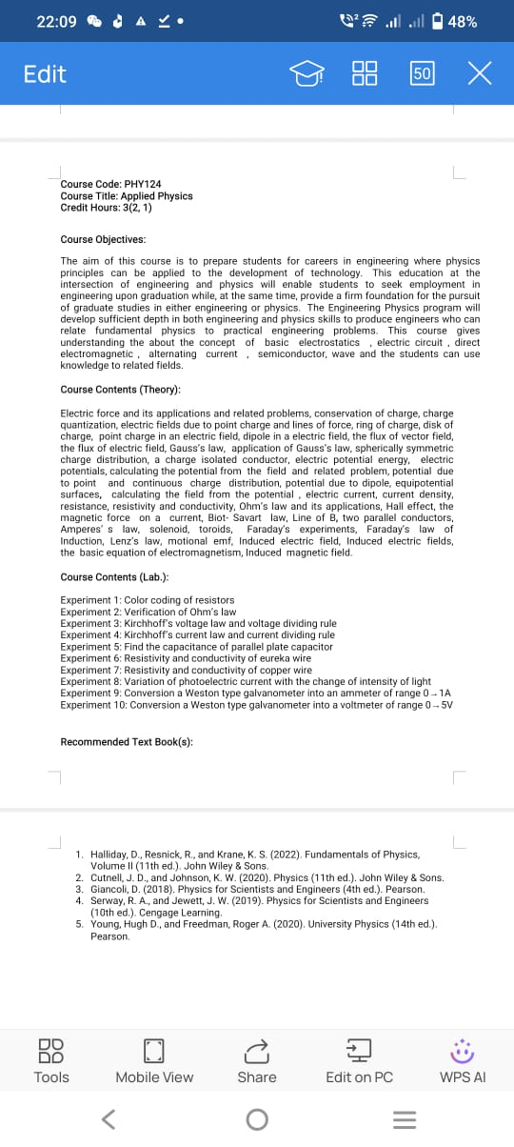

Slide 4
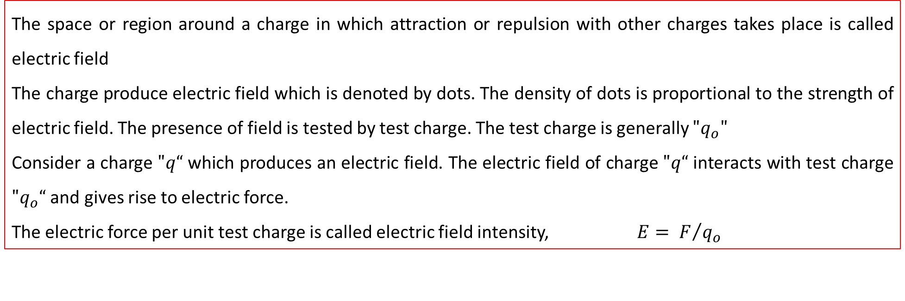
Electric field
The space or region around a charge in which attraction or repulsion with other charges takes place is called electric field
The charge produce electric field which is denoted by dots. The density of dots is proportional to the strength of electric field. The presence of field is tested by test charge. The test charge is generally $"q_{o}"$
Consider a charge $"q“$ which produces an electric field. The electric field of charge $"q“$ interacts with test charge $"q_{o}“$ and gives rise to electric force.
The electric force per unit test charge is called electric field intensity, $E= F/{q_{o}}$
Direction of Electric field
The electric field is a vector quantity and electric field lines gives its direction.
The electric field lines come out from the positive charge and enter into negative charge.
The two electric fields never cross each other.
SI, Unit of electric field is N/C or V/m

Slide 5
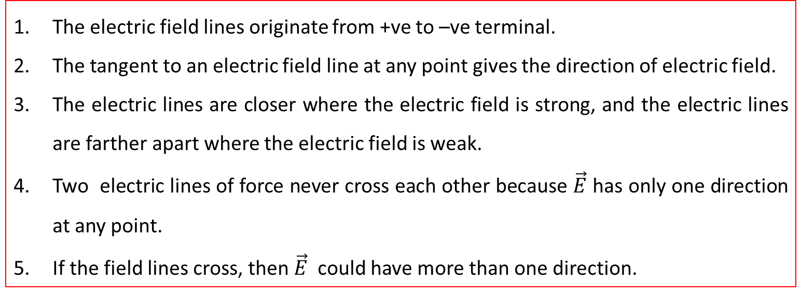
Properties of Electric field
The electric field lines originate from +ve to –ve terminal.
The tangent to an electric field line at any point gives the direction of electric field.
The electric lines are closer where the electric field is strong, and the electric lines are farther apart where the electric field is weak.
Two electric lines of force never cross each other because $\vec{E}$ has only one direction at any point.
If the field lines cross, then $\vec{E}$ could have more than one direction.

Slide 6
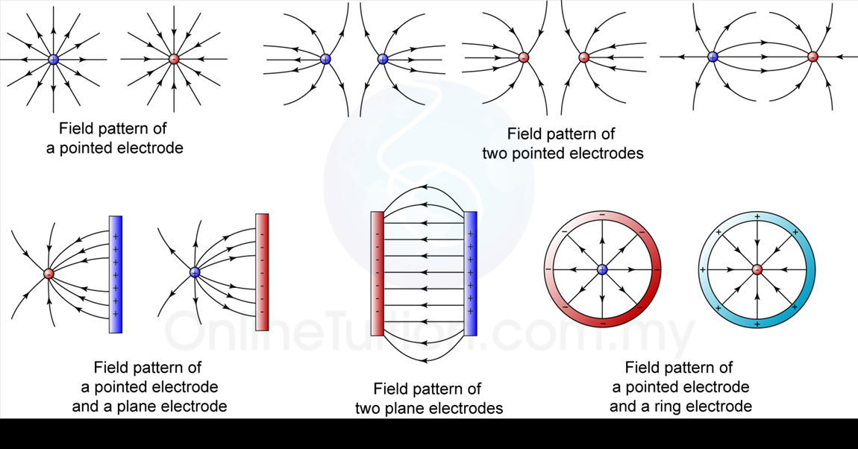

Slide 7
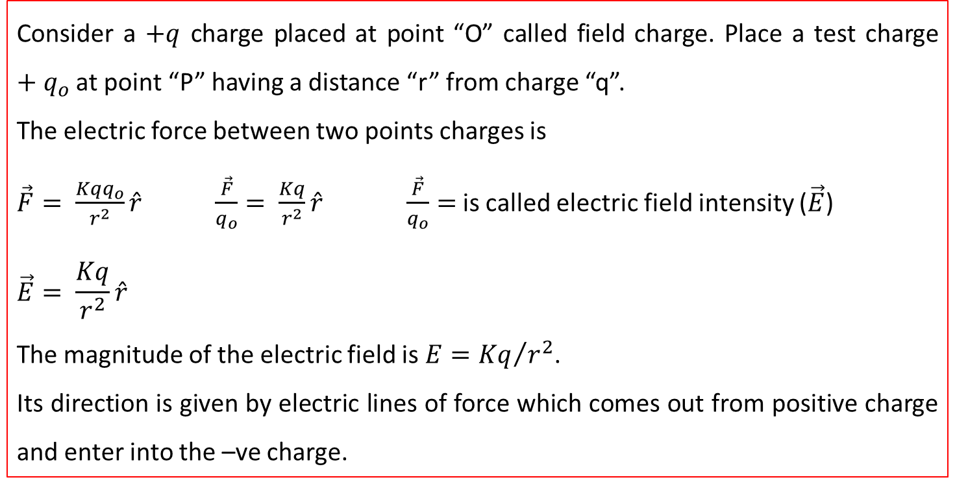


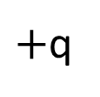



Electric field due to a pinot charge
Consider a $+q$ charge placed at point “O” called field charge. Place a test charge $+q_{o}$ at point “P” having a distance “r” from charge “q”.
The electric force between two points charges is
$\vec{F}= \frac{Kqq_{o}}{r^{2}}\hat{r}$ $\frac{\vec{F}}{q_{o}}= \frac{Kq}{r^{2}}\hat{r}$ $\frac{\vec{F}}{q_{o}}=$ is called electric field intensity ($\vec{E}$)
$$\vec{E}= \frac{Kq}{r^{2}}\hat{r}$$
The magnitude of the electric field is $E={Kq}/{r^{2}}$.
Its direction is given by electric lines of force which comes out from positive charge and enter into the –ve charge.
$$\vec{E}$$
$$P$$
$${+q}_{o}$$
$$O$$
$$r$$
$+$q

Slide 8
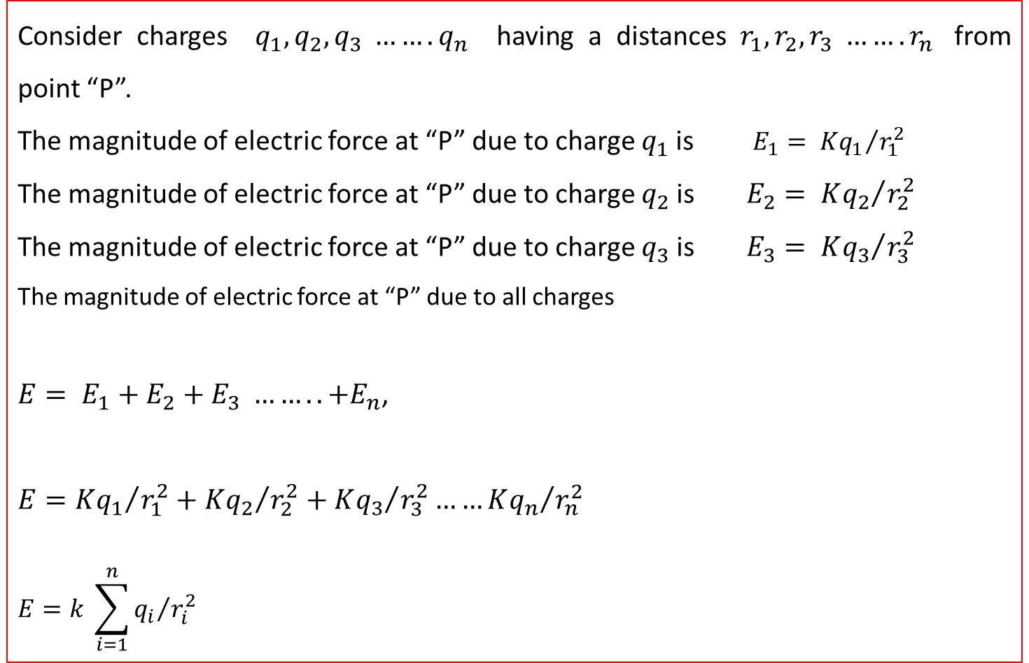
Electric field due to a N-pinot charges
Consider charges $q_{1},q_{2},q_{3} …….q_{n}$ having a distances $r_{1},r_{2},r_{3} …….r_{n}$ from point “P”.
The magnitude of electric force at “P” due to charge $q_{1}$is $E_{1}= {Kq_{1}}/{r_{1}^{2}}$
The magnitude of electric force at “P” due to charge $q_{2}$is $E_{2}= {Kq_{2}}/{r_{2}^{2}}$
The magnitude of electric force at “P” due to charge $q_{3}$is $E_{3}= {Kq_{3}}/{r_{3}^{2}}$
The magnitude of electric force at “P” due to all charges
$E= E_{1}+E_{2}+E_{3} ……..+E_{n}$,
$$E={Kq_{1}}/{r_{1}^{2}}+{Kq_{2}}/{r_{2}^{2}}+{Kq_{3}}/{r_{3}^{2}}……{Kq_{n}}/{r_{n}^{2}}$$
$$E=k \sum_{i=1}^{n}{{q_{i}}/{r_{i}^{2}}}$$

Slide 9





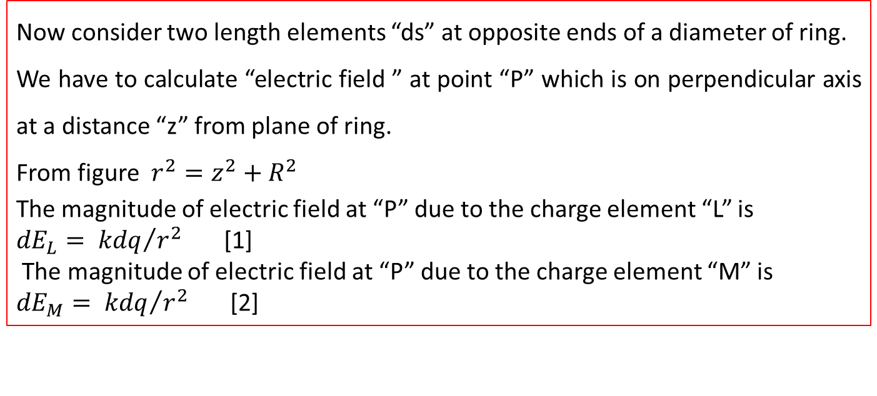

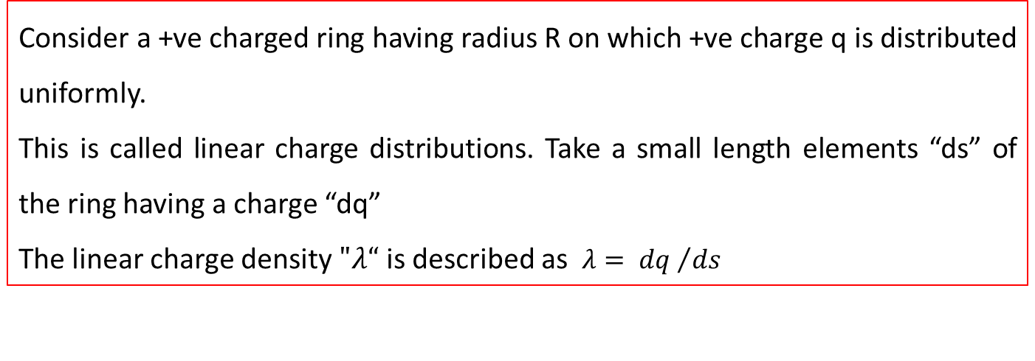








Electric field due to a ring of charge
$${dE}_{Ly}$$
Consider a +ve charged ring having radius R on which +ve charge q is distributed uniformly.
This is called linear charge distributions. Take a small length elements “ds” of the ring having a charge “dq”
The linear charge density $"λ“$ is described as $λ= {dq }/{ds}$
$${dE}_{My}$$
$${dE}_{M}$$
$${dE}_{L}$$
$$θ$$
$$θ$$
$${dE}_{Mx}$$
$${dE}_{Lx}$$
$$P$$
$$r$$
$$z$$
Now consider two length elements “ds” at opposite ends of a diameter of ring.
We have to calculate “electric field ” at point “P” which is on perpendicular axis at a distance “z” from plane of ring.
From figure $r^{2}=z^{2}+R^{2}$
The magnitude of electric field at “P” due to the charge element “L” is
${dE}_{L}= {kdq}/{r^{2}}$ [1]
The magnitude of electric field at “P” due to the charge element “M” is
${dE}_{M}= {kdq}/{r^{2}}$ [2]
$$θ$$
M
$$L$$
$$R$$

Slide 10
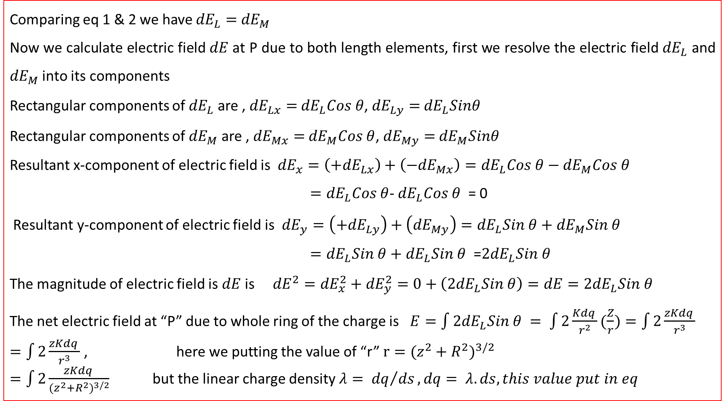
Comparing eq 1 & 2 we have ${dE}_{L}=$ ${dE}_{M}$
Now we calculate electric field $dE$at P due to both length elements, first we resolve the electric field ${dE}_{L}$ and ${dE}_{M}$ into its components
Rectangular components of ${dE}_{L}$ are , ${dE}_{Lx}=$ ${dE}_{L}Cos θ$, ${dE}_{Ly}=$ ${dE}_{L}Sinθ$
Rectangular components of ${dE}_{M}$ are , ${dE}_{Mx}=$ ${dE}_{M}Cos θ$, ${dE}_{My}=$ ${dE}_{M}Sinθ$
Resultant x-component of electric field is ${dE}_{x}=\left(+{dE}_{Lx}\right)+\left({−dE}_{Mx}\right)={dE}_{L}Cos θ−{dE}_{M}Cos θ$
$={dE}_{L}Cos θ$- ${dE}_{L}Cos θ$ = 0
Resultant y-component of electric field is ${dE}_{y}=\left(+{dE}_{Ly}\right)+\left({dE}_{My}\right)={dE}_{L}Sin θ+{dE}_{M}Sin θ$
$={dE}_{L}Sin θ+$ ${dE}_{L}Sin θ$ =${2dE}_{L}Sin θ$
The magnitude of electric field is $dE$ is ${dE}^{2}={dE}_{x}^{2}+{dE}_{y}^{2}=0+\left({2dE}_{L}Sin θ\right)=dE={2dE}_{L}Sin θ$
The net electric field at “P” due to whole ring of the charge is $E=\int{{2dE}_{L}Sin θ }= \int{2\frac{Kdq }{r^{2}}(\frac{Z}{r})}=\int{2\frac{zKdq }{r^{3}}}$
$=\int{2\frac{zKdq }{r^{3}}}$ , here we putting the value of “r” $r={(z^{2}+R^{2})}^{3/2}$
$=\int{2\frac{zKdq }{{(z^{2}+R^{2})}^{3/2}}}$ but the linear charge density $λ= {dq}/{ds}, dq= λ.ds, this value put in eq$

Slide 11
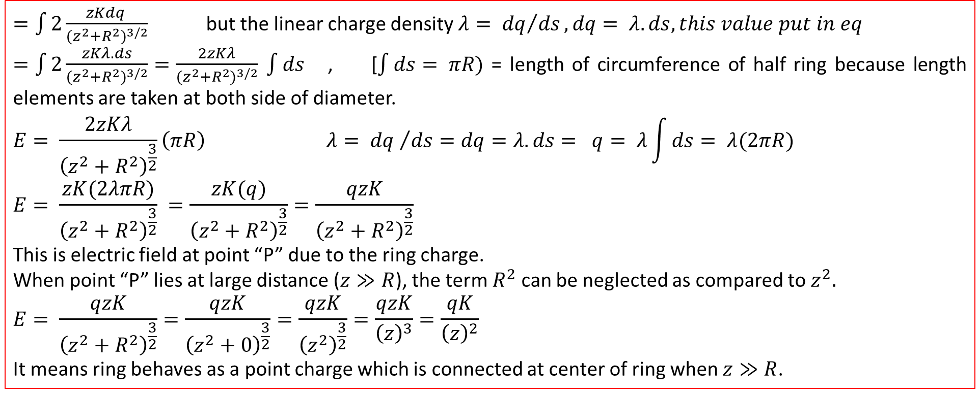
$=\int{2\frac{zKdq }{{(z^{2}+R^{2})}^{3/2}}}$ but the linear charge density $λ= {dq}/{ds}, dq= λ.ds, this value put in eq$
$=\int{2\frac{zKλ.ds}{{(z^{2}+R^{2})}^{3/2}}}=\frac{2zKλ}{{(z^{2}+R^{2})}^{3/2}} \int{ds}$ , [$\int{ds}= πR)$ = length of circumference of half ring because length elements are taken at both side of diameter.
$$E= \frac{2zKλ}{{\left(z^{2}+R^{2}\right)}^{\frac{3}{2}}}\left(πR\right) λ= {dq }/{ds}=dq=λ.ds= q= λ\int{ds}= λ(2πR)$$
$$E= \frac{zK(2λπR)}{{\left(z^{2}+R^{2}\right)}^{\frac{3}{2}}} =\frac{zK(q)}{{\left(z^{2}+R^{2}\right)}^{\frac{3}{2}}}=\frac{qzK}{{\left(z^{2}+R^{2}\right)}^{\frac{3}{2}}}$$
This is electric field at point “P” due to the ring charge.
When point “P” lies at large distance ($z≫R$), the term $R^{2}$ can be neglected as compared to $z^{2}.$
$$E= \frac{qzK}{{\left(z^{2}+R^{2}\right)}^{\frac{3}{2}}}=\frac{qzK}{{\left(z^{2}+0\right)}^{\frac{3}{2}}}=\frac{qzK}{{\left(z^{2}\right)}^{\frac{3}{2}}}=\frac{qzK}{{\left(z\right)}^{3}}=\frac{qK}{{\left(z\right)}^{2}}$$
It means ring behaves as a point charge which is connected at center of ring when $z≫R$.

Slide 12
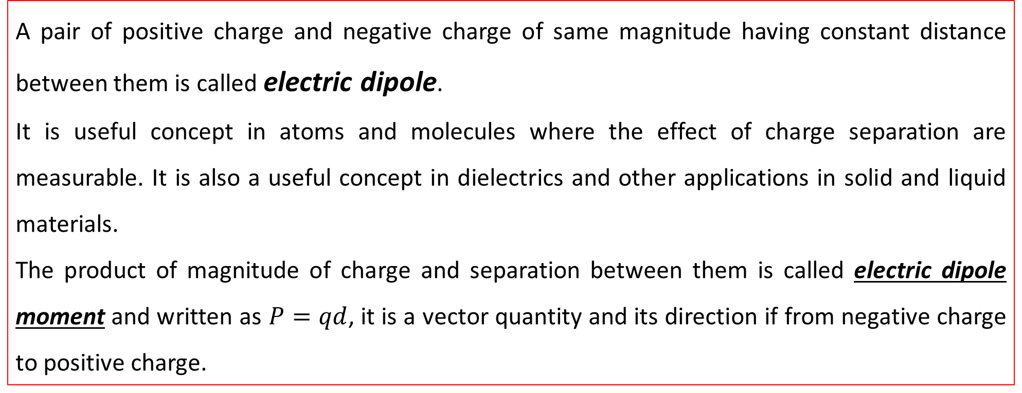
Electric field due to an electric dipole
A pair of positive charge and negative charge of same magnitude having constant distance between them is called electric dipole.
It is useful concept in atoms and molecules where the effect of charge separation are measurable. It is also a useful concept in dielectrics and other applications in solid and liquid materials.
The product of magnitude of charge and separation between them is called electric dipole moment and written as $P=qd$, it is a vector quantity and its direction if from negative charge to positive charge.

Slide 13



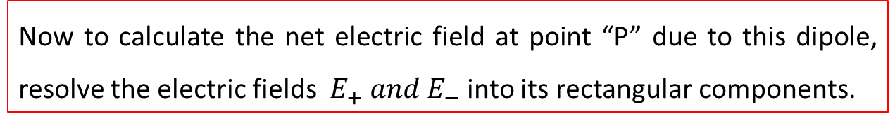



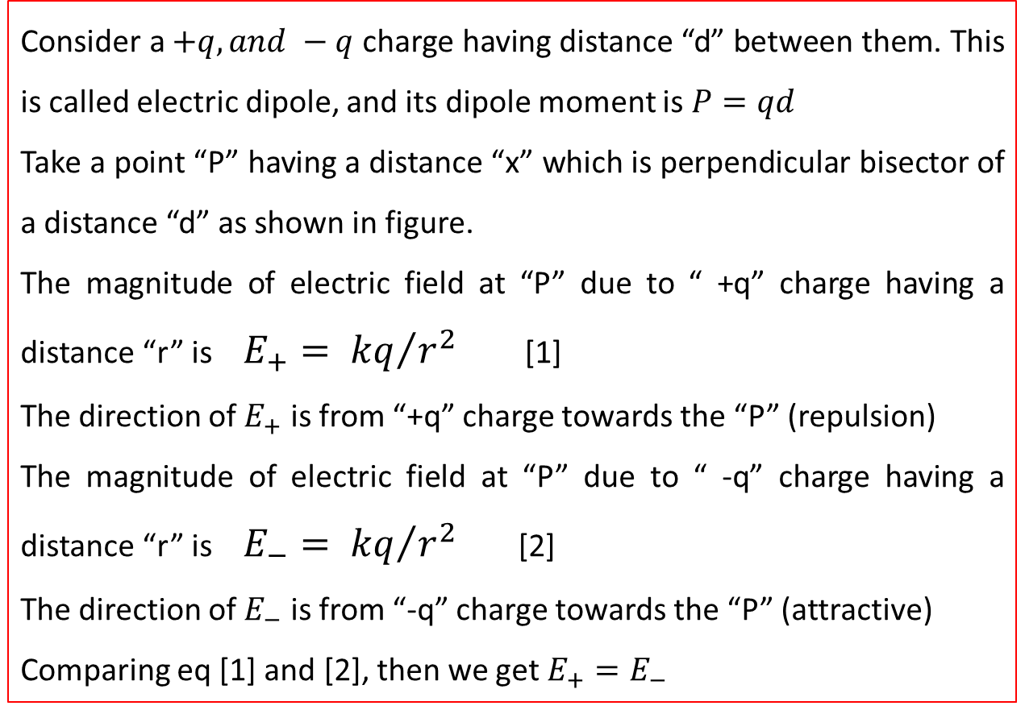











Consider a $+q, and −q$ charge having distance “d” between them. This is called electric dipole, and its dipole moment is $P=qd$
Take a point “P” having a distance “x” which is perpendicular bisector of a distance “d” as shown in figure.
The magnitude of electric field at “P” due to “ +q” charge having a distance “r” is $E_{+}= {kq}/{r^{2}}$ [1]
The direction of $E_{+}$ is from “+q” charge towards the “P” (repulsion)
The magnitude of electric field at “P” due to “ -q” charge having a distance “r” is $E_{−}= {kq}/{r^{2}}$ [2]
The direction of $E_{−}$ is from “-q” charge towards the “P” (attractive)
Comparing eq [1] and [2], then we get $E_{+}=E_{−}$
$$+q$$
$$y$$
r
$$E$$
$$d/2$$
$$x$$
P
$$x$$
$$O$$
$$P$$
$$E_{−x}$$
$$E_{+x}$$
$$E$$
$$d/2$$
$$E_{−}$$
$$E_{+y}$$
$$E_{+}$$
$$−q$$
$$E_{−y}$$
Now to calculate the net electric field at point “P” due to this dipole, resolve the electric fields $E_{+} and E_{−}$ into its rectangular components.

Slide 14
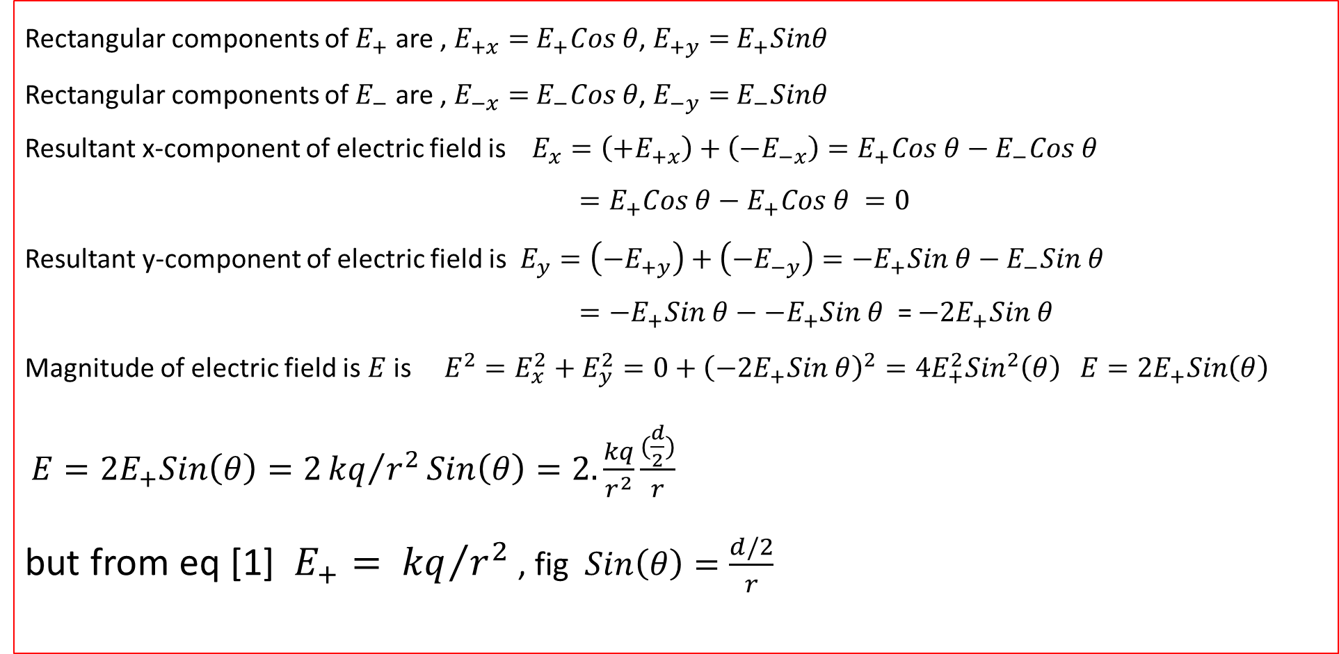

Resolve the electric field “$E_{+}$” $E_{−}$ into its rectangular components
Rectangular components of $E_{+}$ are , $E_{+x}=$ $E_{+}Cos θ$, $E_{+y}=$ $E_{+}Sinθ$
Rectangular components of $E_{−}$ are , $E_{−x}=$ $E_{−}Cos θ$, $E_{−y}=$ $E_{−}Sinθ$
Resultant x-component of electric field is $E_{x}=\left(+E_{+x}\right)+\left({−E}_{−x}\right)=E_{+}Cos θ−E_{−}Cos θ$
$=E_{+}Cos θ−E_{+}Cos θ =0$
Resultant y-component of electric field is $E_{y}=\left(−E_{+y}\right)+\left({−E}_{−y}\right)={−E}_{+}Sin θ−E_{−}Sin θ$
$={−E}_{+}Sin θ−$ ${−E}_{+}Sin θ$ = $−{2E}_{+}Sin θ$
Magnitude of electric field is $E$ is $E^{2}=E_{x}^{2}+E_{y}^{2}=0+{\left({−2E}_{+}Sin θ\right)}^{2}={4E}_{+}^{2}{Sin}^{2}\left(θ\right) E={2E}_{+}Sin\left(θ\right)$
$E={2E}_{+}Sin\left(θ\right)=2{kq}/{r^{2}}Sin\left(θ\right)=2.\frac{kq}{r^{2}}\frac{(\frac{d}{2})}{r}$
but from eq [1] $E_{+}= {kq}/{r^{2}}$ , fig $Sin\left(θ\right)=\frac{d/2}{r}$
$$but E_{+}= E_{−}$$

Slide 15
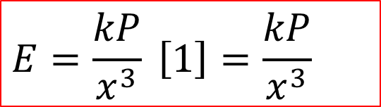
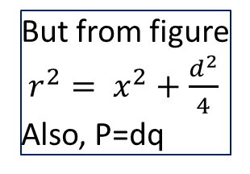

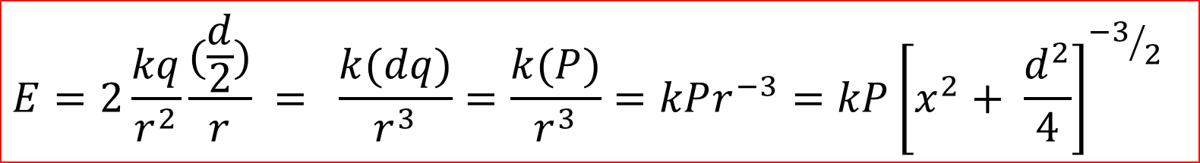
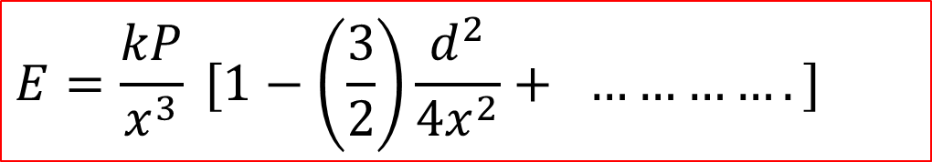
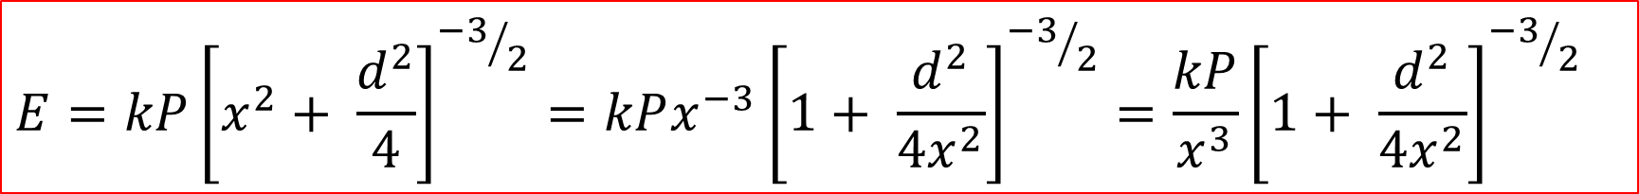
$$E=2\frac{kq}{r^{2}}\frac{(\frac{d}{2})}{r} = \frac{k(dq)}{r^{3}}=\frac{k(P)}{r^{3}}=kPr^{−3}=kP{\left[x^{2}+ \frac{d^{2}}{4}\right]}^{{−3}/2}$$
But from figure
$r^{2}= x^{2}+\frac{d^{2}}{4}$
Also, P=dq
$$E=kP{\left[x^{2}+ \frac{d^{2}}{4}\right]}^{{−3}/2}=kPx^{−3}{\left[1+ \frac{d^{2}}{4x^{2}}\right]}^{{−3}/2}=\frac{kP}{x^{3}}{\left[1+ \frac{d^{2}}{4x^{2}}\right]}^{{−3}/2}$$
$$Expand the term in bracket by bionomial therom$$
$$E=\frac{kP}{x^{3}} [1−\left(\frac{3}{2}\right)\frac{d^{2}}{4x^{2}}+ ………….]$$
$$Neglect the higher terms, we get$$
This is the electric field at “P” due to electric dipole. Where “x” is distance between point “p” and bisecting point “O” of distance between “+q” and “-q”.
$$E=\frac{kP}{x^{3}} \left[1\right]=\frac{kP}{x^{3}}$$

Slide 16
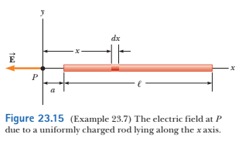
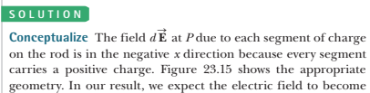
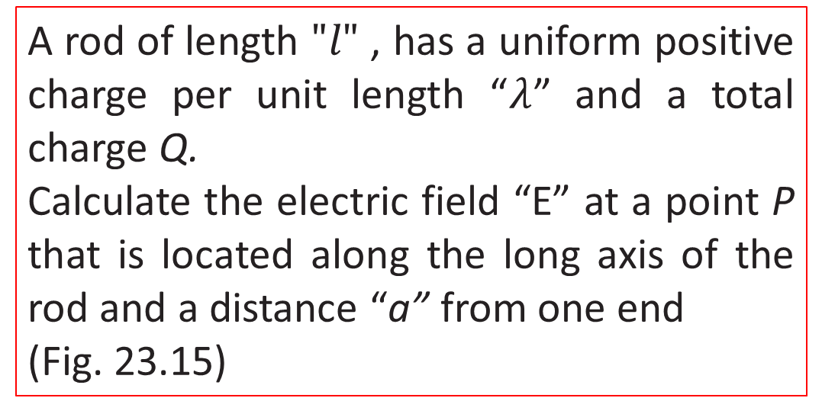
A rod of length $"l"$ , has a uniform positive charge per unit length “$λ$” and a total charge Q.
Calculate the electric field “E” at a point P that is located along the long axis of the rod and a distance “a” from one end
(Fig. 23.15)

Slide 17
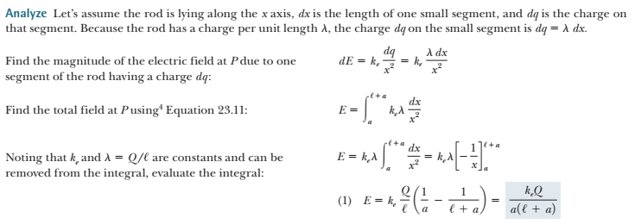

Slide 18
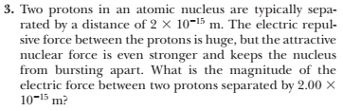
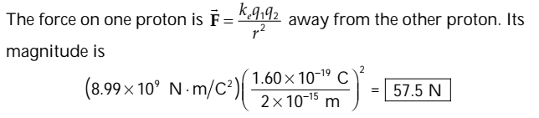

Slide 19

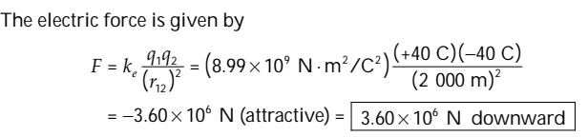

Slide 20
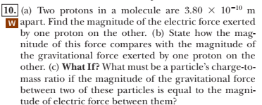
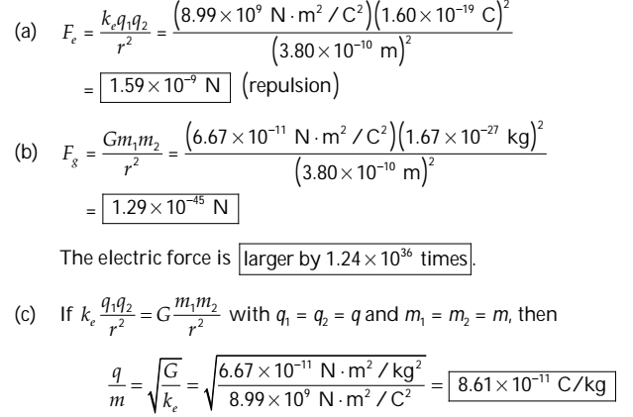

Slide 21
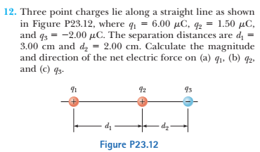
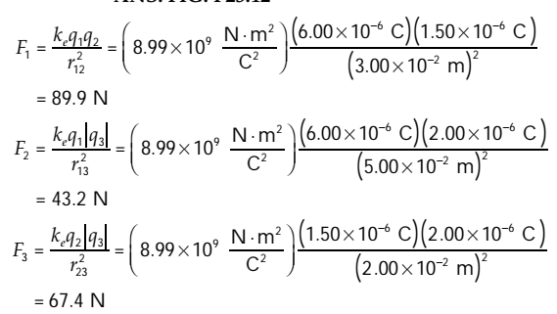

Slide 22
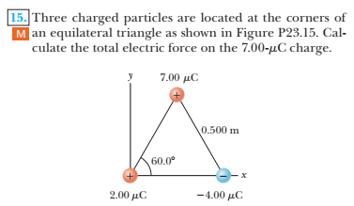
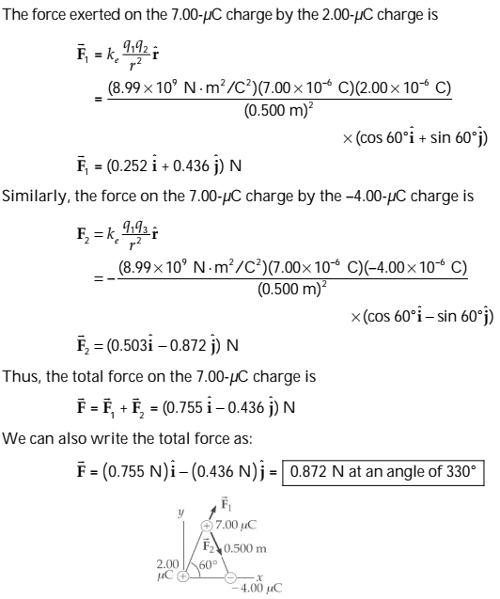

Slide 23
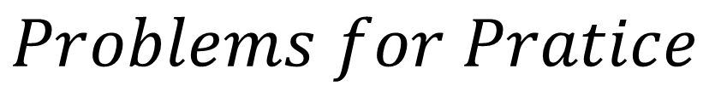
$$Problems for Pratice$$

Slide 24
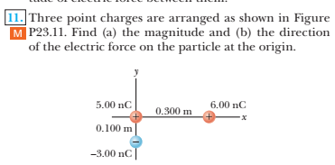
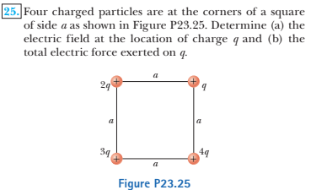
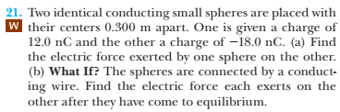

Slide 25
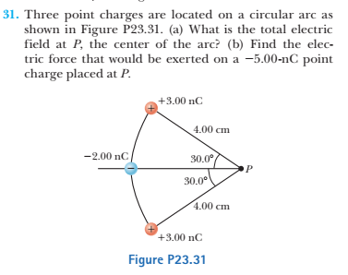
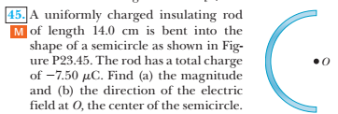


Slide 26

$$Book conceptual questions$$
$$with answers$$

Slide 27
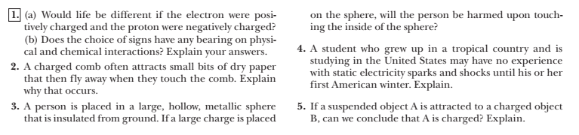
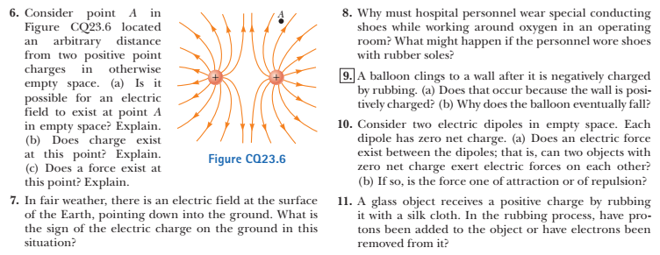

Slide 28
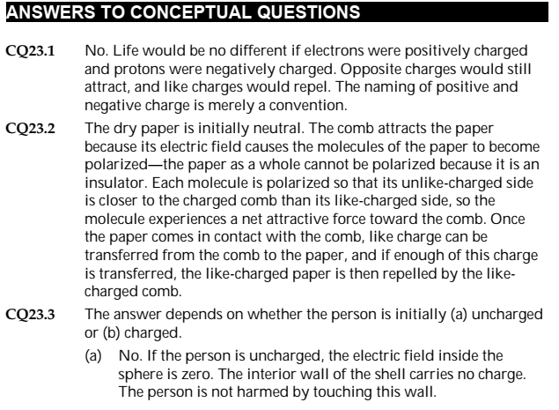
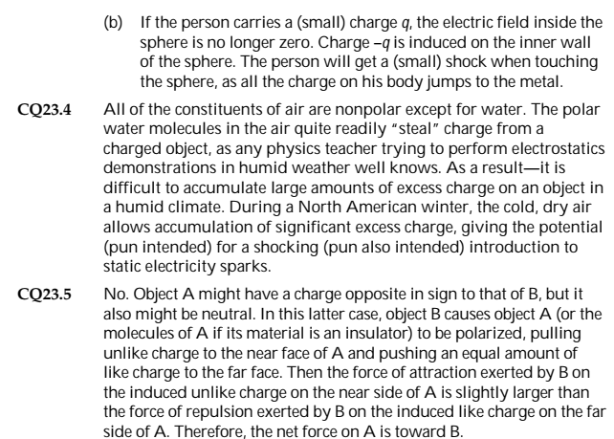

Slide 29
